Slide 1
Career Services
Julie Shelton, Director of Career and Vocational Services

Slide 2
Resources from Career Services
Assessments and Job Shadowing
Resumes/Cover Letters
Volunteer and Community Involvement
Internship Assistance
Part-Time Job Opportunities and Summer Job Experience
On-Campus Work Study Opportunities
Graduate School Fairs/Meetings
Career Fairs/Meetings
Handshake
Job Search, Interview Preparation and Negotiating Salary
Networking

Slide 3
Resumes
Tips
Format
Step by Step

Slide 4
Resume tips from Google and Microsoft
Use .pdf format to save and send documents.
Check for typos. Check for typos. Check for typos.
Bullets make information jump off the page, use them.
Don't forget your contact information, they can't get back to you without it.
Keep resumes simple, use formatting that presents a clean and uncluttered look.
Show your impact as you describe your duties, quantify by using data.
GPA is important/GPA is not everything.
Avoid a 3-page resume.
Volunteer, then include it.
Get involved with campus groups.

Slide 5
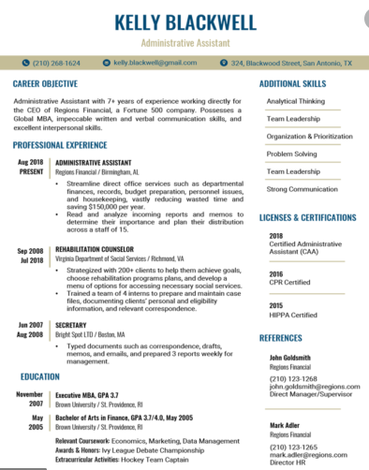
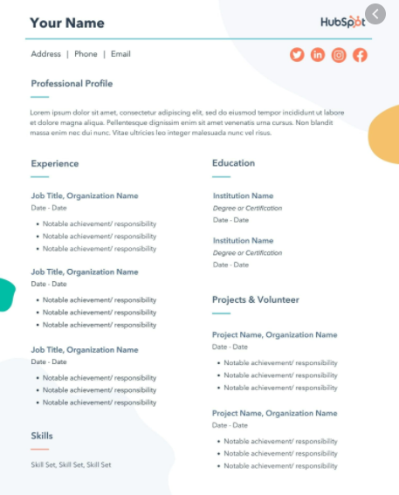
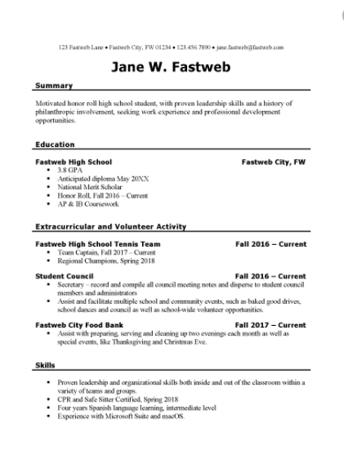
Resume Format 101
You want your resume to be the best it can be,
you don’t want it to look messy, outdated, or hard to read.
#1 #2 #3

Slide 6
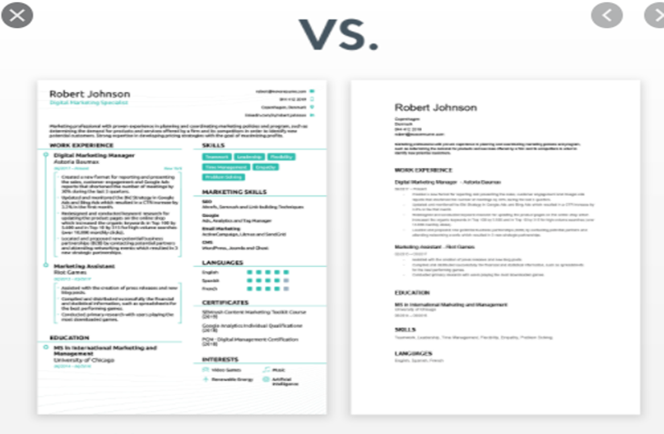
Examples:

Slide 7
Step by Step Resume: Introduction
Flame The Firehawk
flamfire123@utsouthern.edu | (931) 363-9800 | Pulaski, TN 38478
*Tips: Do not abbreviate; list an appropriate,
frequently checked email address
(be sure the email address is not hyperlinked)

Slide 8
Education
The University of Tennessee Southern - Pulaski, TN Anticipated Graduation May 2025
Bachelor’s Degree in …. (refer to the catalog for actual degree)
Emphasis in (if applicable)
GPA, (if above a 3.0) | Chancellor’s List, Fall 2022 (example)
Courses include: 300 level and above and relevant (italicize)
Memberships: Academic Clubs/Organizations/Athletics, dates of membership
*Tip: High school is no longer necessary after your sophomore year in college (in most cases).

Slide 9
Experience
Company (official name) Location Dates
Job Title
Responsibilities include: list 2 – 3 specific duties that would show that you have skills and experience to offer (keep it short and specific). Start each statement with a strong action verb: created, conducted, managed, supervised, for example. Quantify your impact using data/numbers (in any area of your resume).
*Tips: List the last 4 years of employment, you can include any job shadowing/internship experience you may have under this category. You do not have to list every job you have had all through high school/college. List most recent to least recent.

Slide 10
Skills
Check the job description and list skills that are:
Relevant to the position AND in the job description
Transferrable Soft Skills: *people skills
Leadership skills (conflict resolution, delegation, problem solving)
Organizational skills (goal setting, dependability, scheduling)
Management skills (forecasting, public speaking, mentoring)
Transferrable Hard Skills: *teachable abilities
Language fluency
Computer skills (G Suite, Microsoft Office 365, HTML, cloud management)
Writing (technical writing, copywriting, blogging)
Spreadsheets (Excel, Google Sheets)
Marketing (search engine optimization, Google AdWords, Google Analytics)

Slide 11
Volunteer Experience
Example:
Dodge County Animal Shelter, dates
Volunteer board member, …
Local Red Cross chapter, dates
Regular volunteer, …
Habitat for Humanity, dates
Volunteer, …
*Tip: List at least 3 opportunities you had to give back to your community within the last 4 years and briefly discuss your experience/responsibilities. This is an opportunity to show learned transferrable skills and that you are a well rounded person. This can include volunteer coaching and/or events related to your church/community.

Slide 12
References
Name (Mr., Ms., Dr., Coach)
Job Title (Official)
Company
Company Address
Email Address
Phone Number
Relationship: (how do you know this person and for how long have you know them)
*Tip: Ask permission to list prior to listing them and be sure they will give you a good reference; your references can not be a relative; list at least 3 references (references are on a separate page); list a variety of references, for example: a coach/supervisor/professor, someone that has seen you in a productive capacity.

Slide 13
Keep References Connected
Your references are your advisors, mentors, networking community, they are VERY important in your career path.
Ask permission prior to listing and even as early as now, try to identify and connect with professionals that could be a great reference or mentor throughout your college career.
When you apply, notify your references, send them the job description so they understand what traits the employer needs and they can be prepared to speak on your behalf.
Let your reference know how the job inquiry/interview went and thank them!

Slide 14
Resume Recap
Categories (5 - 6):
Introduction
Education
Experience
Skills
Volunteer Experience
References

Slide 15
Flame The FireHawk Pulaski, Tennessee 38478 | linkedin.com/in/fire-firehawk-392b55 ffireha123@utsouthern.edu | (931) 363-0000
EDUCATION
University of Tennessee Southern Pulaski, Tennessee Anticipated Graduation May 2021
Bachelor’s Degree (refer to the catalog for degree title)
Emphasis in (if applicable)
GPA (above a 3.0) | Dean’s List, Fall 2020 (example)
Courses include: List 300/400 level courses that are relevant to the opportunity
Option-List any relevant UTS affiliations here. This includes athletics, clubs/organizations, honors and scholarships (subtitle, italicize and indent).
EXPERIENCE
Company Name Location Dates
Responsibilities: list 2 – 3 specific duties that would show that you have skills and experience to offer (keep it short and specific, use action verbs)
COMMUNITY OUTREACH
Company, dates (list most recent first)
Program and responsibilities (what did you experience?)

Slide 16
Social Media Presence
When employers review your resume, if you are a viable candidate, they will check your social media.
This will determine if you make it to the interview.
Make sure your social media reflects a respectable potential employee.
Stay away from political, religious rants and personal issues.
Focus on posting articles related to your field of study and posts supporting your community.

Slide 17
Handshake
Join TODAY: https://joinhandshake.com/students/how-it-works/
Download the app:
Set up your profile (using your UTS credentials), very similar to setting up any other social media profile.
Hiring employers looking for young professionals in college and new graduates.
Find Internships and summer jobs.
Employers will message you!

Slide 18
Interview 101
Interviewing tips to keep in mind:
Research the company and the people
Prepare a 30 second elevator pitch
Clarify your selling points and why you want the job
Anticipate the interviewers concerns and reservations
Prepare for the common interview questions
Be ready for behavior-based interview questions
Have a few questions for the interviewer, this will come from your research
Follow up after the interview (within 24/48 hours)

Slide 19
Virtual Interview
Test your technology
Connectivity, camera, lighting (from the front), microphone (echo)
Day of interview test again an hour before the interview (being able to navigate through technology is one of the top 10 traits employers are looking for these days)
Set the scene and minimize distractions
Make sure YOU are the focal point and your background is NOT
Be prepared and don’t “click” around, stay focused
Take notes and have a printed copy of your resume for talking points
Monitor your body language and dress the part
Sit up straight, have your camera eye level, smile
Make a connection, be yourself, and follow up!
It’s good to set yourself apart from the other candidates by offering a side story about a common interest. Be courteous of time and be sure it’s appropriate.

Slide 20
Dress for Success
Tips on dressing for an interview (or any professional event):
Neatly groomed hair, well groomed facial hair (or none)
Minimal, simple make-up and clear nail polish
Minimal, simple jewelry/(men) no earrings
Cover tattoos
No perfume or cologne
Clothes must be clean, ironed & fit properly
Belt and shoes match; Simple/classic socks and tie
Simple colors and minimal patterns
Bring portfolio (no phone/purse)

Slide 21
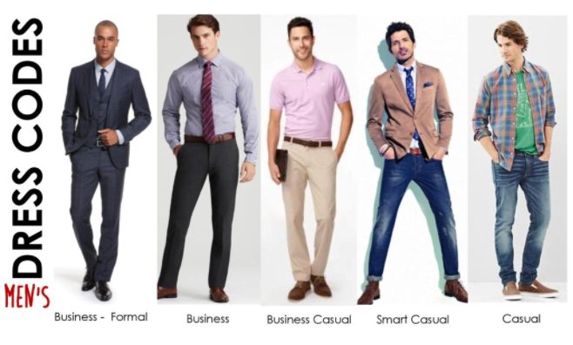

Slide 22
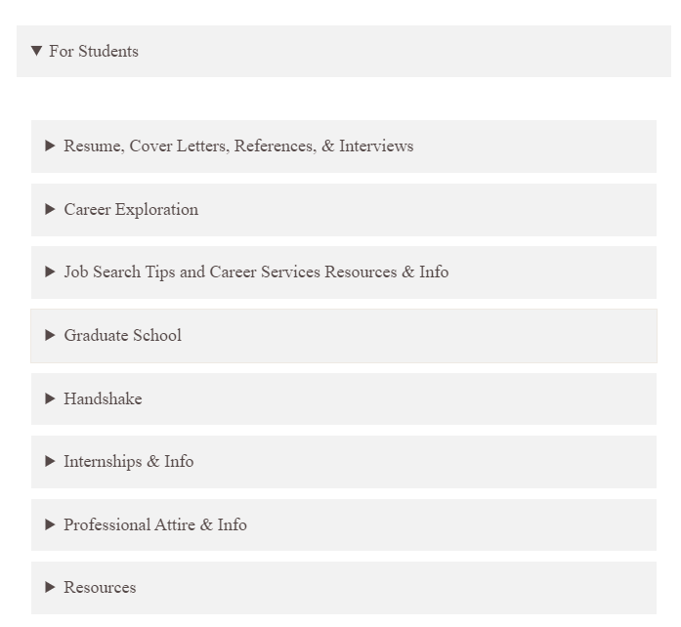
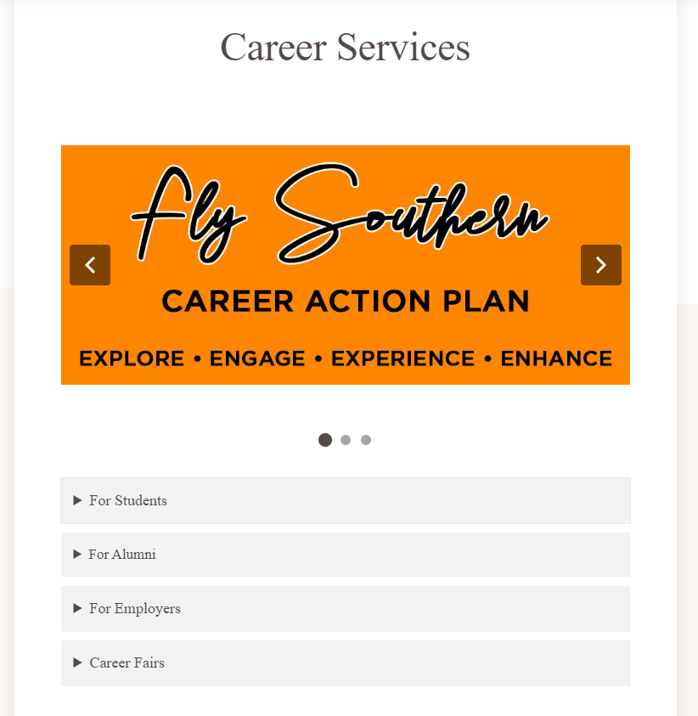
UT Southern Website for Resources:
https://utsouthern.edu/

Slide 23
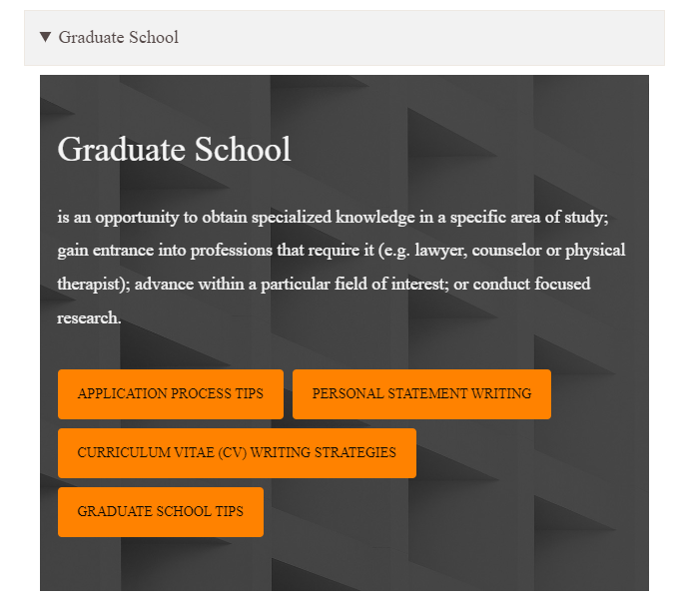
Graduate School
This is a lot like looking for a job, do lots of research, start now!
Deadlines vary but tend to fall between October – February.
Graduate School meetings, available upon request.
RESOURCE:
https://utsouthern.edu/application-process-tips/
https://utsouthern.edu/personal-statement-writing-strategies/
https://utsouthern.edu/curriculum-vitae-cv-writing-strategies/

Slide 24
Federal College Work Study Program
On-Campus Employment
Convenient on-campus work experience
Networking with campus community
Reference opportunities
$8.00 an hour
94 hours per semester
Apply on the UTS website under Career Services

Slide 25
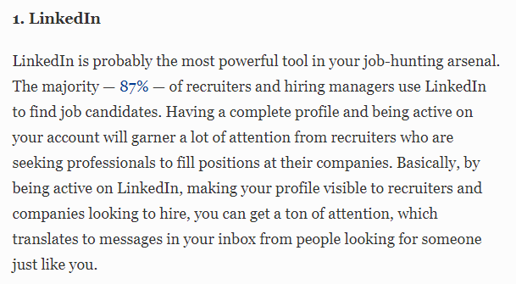
Professional Photos:

Slide 26
Resume Competition

Slide 27
Questions?
Julie Shelton
Career Services
Colonial Hall
jshelt48@utsouthern.edu
931-363-9854
931-309-1938

